Slide 1
Software Framework Validation
Prof Maheswari S,
VIT Chennai

Slide 2
Framework for validation
Identifies the elementary components of measure and measurement process and then consider five more models involved in measurement
Ref: Kitchenham, B., Pfleeger, S. L., & Fenton, N. (1995). Towards a framework for software measurement validation. IEEE Transactions on software Engineering, 21(12), 929-944.

Slide 3
Five Models
Unit definition model
Instrumentation models
Attribute relationship models
Measurement protocols
Entity population models

Slide 4
Outcome
To identify the shortcomings in the measurement process.
Using Vector like techniques, it can compare with other measurement techniques.
Checks the validity of the measurement of the software process.

Slide 5
Validation Techniques
Empirical Validation Process
Complexity Metrics
Representation condition of valid metrics
Identifying the usefulness of a measure for predictive purpose
Measures stated attributes

Slide 6
Objective – Proposed Framework
How to validate a measure
How to assess the validation work of others
When it is appropriate to apply a measure in a particular situation.

Slide 7
Structure of Measurement
Entities, Attributes and Relationships
Units, Scale types and their relationships
Values
Properties of Values
Measurement Instrument
Indirect Measures
Compound Units
Properties of Indirect Measures
Implications of Measurement Validation

Slide 8
Models and Measurement
Unit Definition Models
Instrumentation Models
Attribute Relationship Models

Slide 9
Maturity Levels 1. Adhoc
- Basic Requirements defined

Slide 10
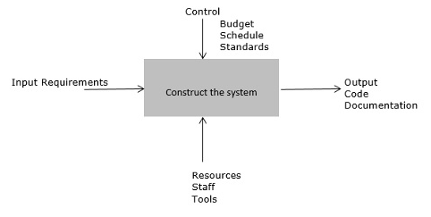
2. Repeatable Process

Slide 11
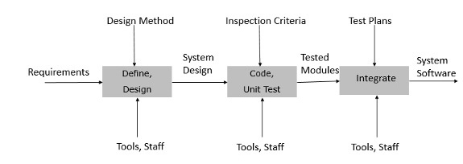
3. Defined

Slide 12
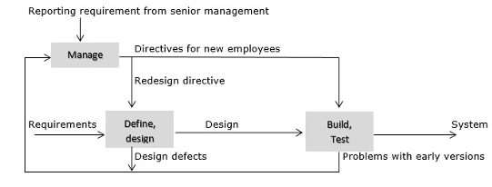
4. Managed

Slide 13
5. Optimizing
The measures from activities are used to improve the process by removing and adding process activities and changing the process structure dynamically in response to measurement feedback.

Slide 14
Software Measurement Validation
Theoretical and Empirical Validation
Example of Empirical Validation (Halstead metrics)

Slide 15
Halstead Metric

Slide 16
THANK YOU

